Slide 1

Integration of OSN-NSDF data movements
Selected science use cases
Alexander Szalay
Johns Hopkins University

Slide 2
The Emergence of Big Science
We are moving from the era of “manual production” of scientific data in small-scale experiments to the “industrial revolution” of Big Science
1920s : Small experiments done by individuals, small groups, slowly growing
1960- : Big Science projects, costing $1B+, take decades, very risk-adverse, data have much longer lifetimes
This is a big difference
Past: Experiments rapidly followed one another, data sets had a short lifetime
Today: Big Science experiments (LIGO, LHC, SKA, LSST, OOI, NEON,…) may not be surpassed by another in our life
SSC ☹
Van der Graaf -> Cyclotron -> Synchrotron -> National Labs
LHC ☺
The data is here to stay (for decades)…

Slide 3
Today’s Science Environment
For a long time science was bimodal, small PI projects vs Big Science
It is changing again today – more in the middle
NSF Mid-Scale projects, NIH U01, private collaborations, public-private partnerships (Sloan Digital Sky Survey, PFS, Human Genome …)
Typically: create a unique instrument, use cutting edge technology, take risks, push budgets to the limit (and beyond) to maximize science, generate large amounts (petabytes) of data
Enormous fresh energy liberated!
At the “sweet spot” for science
Do computations on a shoestring
Good example is the Event Horizon Telescope
Generally: computations will be done opportunistically
In this new model there is much more focus on generating (and sharing) novel data

Slide 4

The Open Storage Network
Science needs a robust cyberinfrastructure with 3 pillars:
Computing Capabilities
Fast Networking
Data-Intensive Infrastructure (still largely missing)
There is a serious impedance mismatch
In the storage layer disk-to-disk transfers are still much slower than the network bandwidth
OSN idea: build an inexpensive standard appliance
Open software stack centrally managed, built on microservices
Ultra-simple, industry standard API: S3 object store
Plug into the 100G Internet2 backbone in the DMZ
8 nodes deployed, extensive testing, system functional/in use
OSN can solve the continental impedance problem

Slide 5
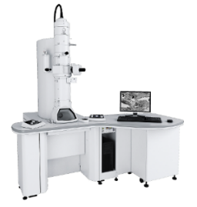
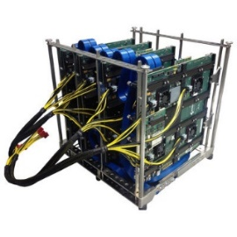
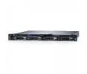
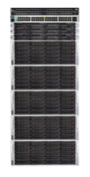
Midscale: the “First Meter” Problem
High throughput instruments have an impedance problem
Both for data rate (few TB/min), and data volume (PB)
Data needs to be first captured at a high rate then transferred to an HPC center for processing (where it is free)
This can be beautifully solved with multiple dedicated local pods acting as high-capacity caches
But: we need to add a customizable SW layer on the back end (compression, data transform) => Points to the NSDF
TEM
FPGA
HPC or cloud
TB/min
N x 100G burst
100G sustained
This problem will be here even when everything will move to the cloud!

Slide 6
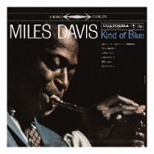


Evolving Data Analysis
The evolution of the music industry is a good example:
LP/CD
=> iTunes
=> Spotify/Pandora
What are the data equivalents?
Download all data
Send tapes, disk, sneakernet
Astronomy archives, SkyServer, IVOA, MAST, NED,…
=> Run queries at project servers
=> Run in the cloud, view the result
Google Colab, SciServer
We are in between today, as keeping data in the cloud costs too much

Slide 7
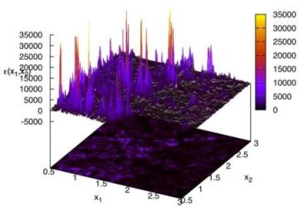
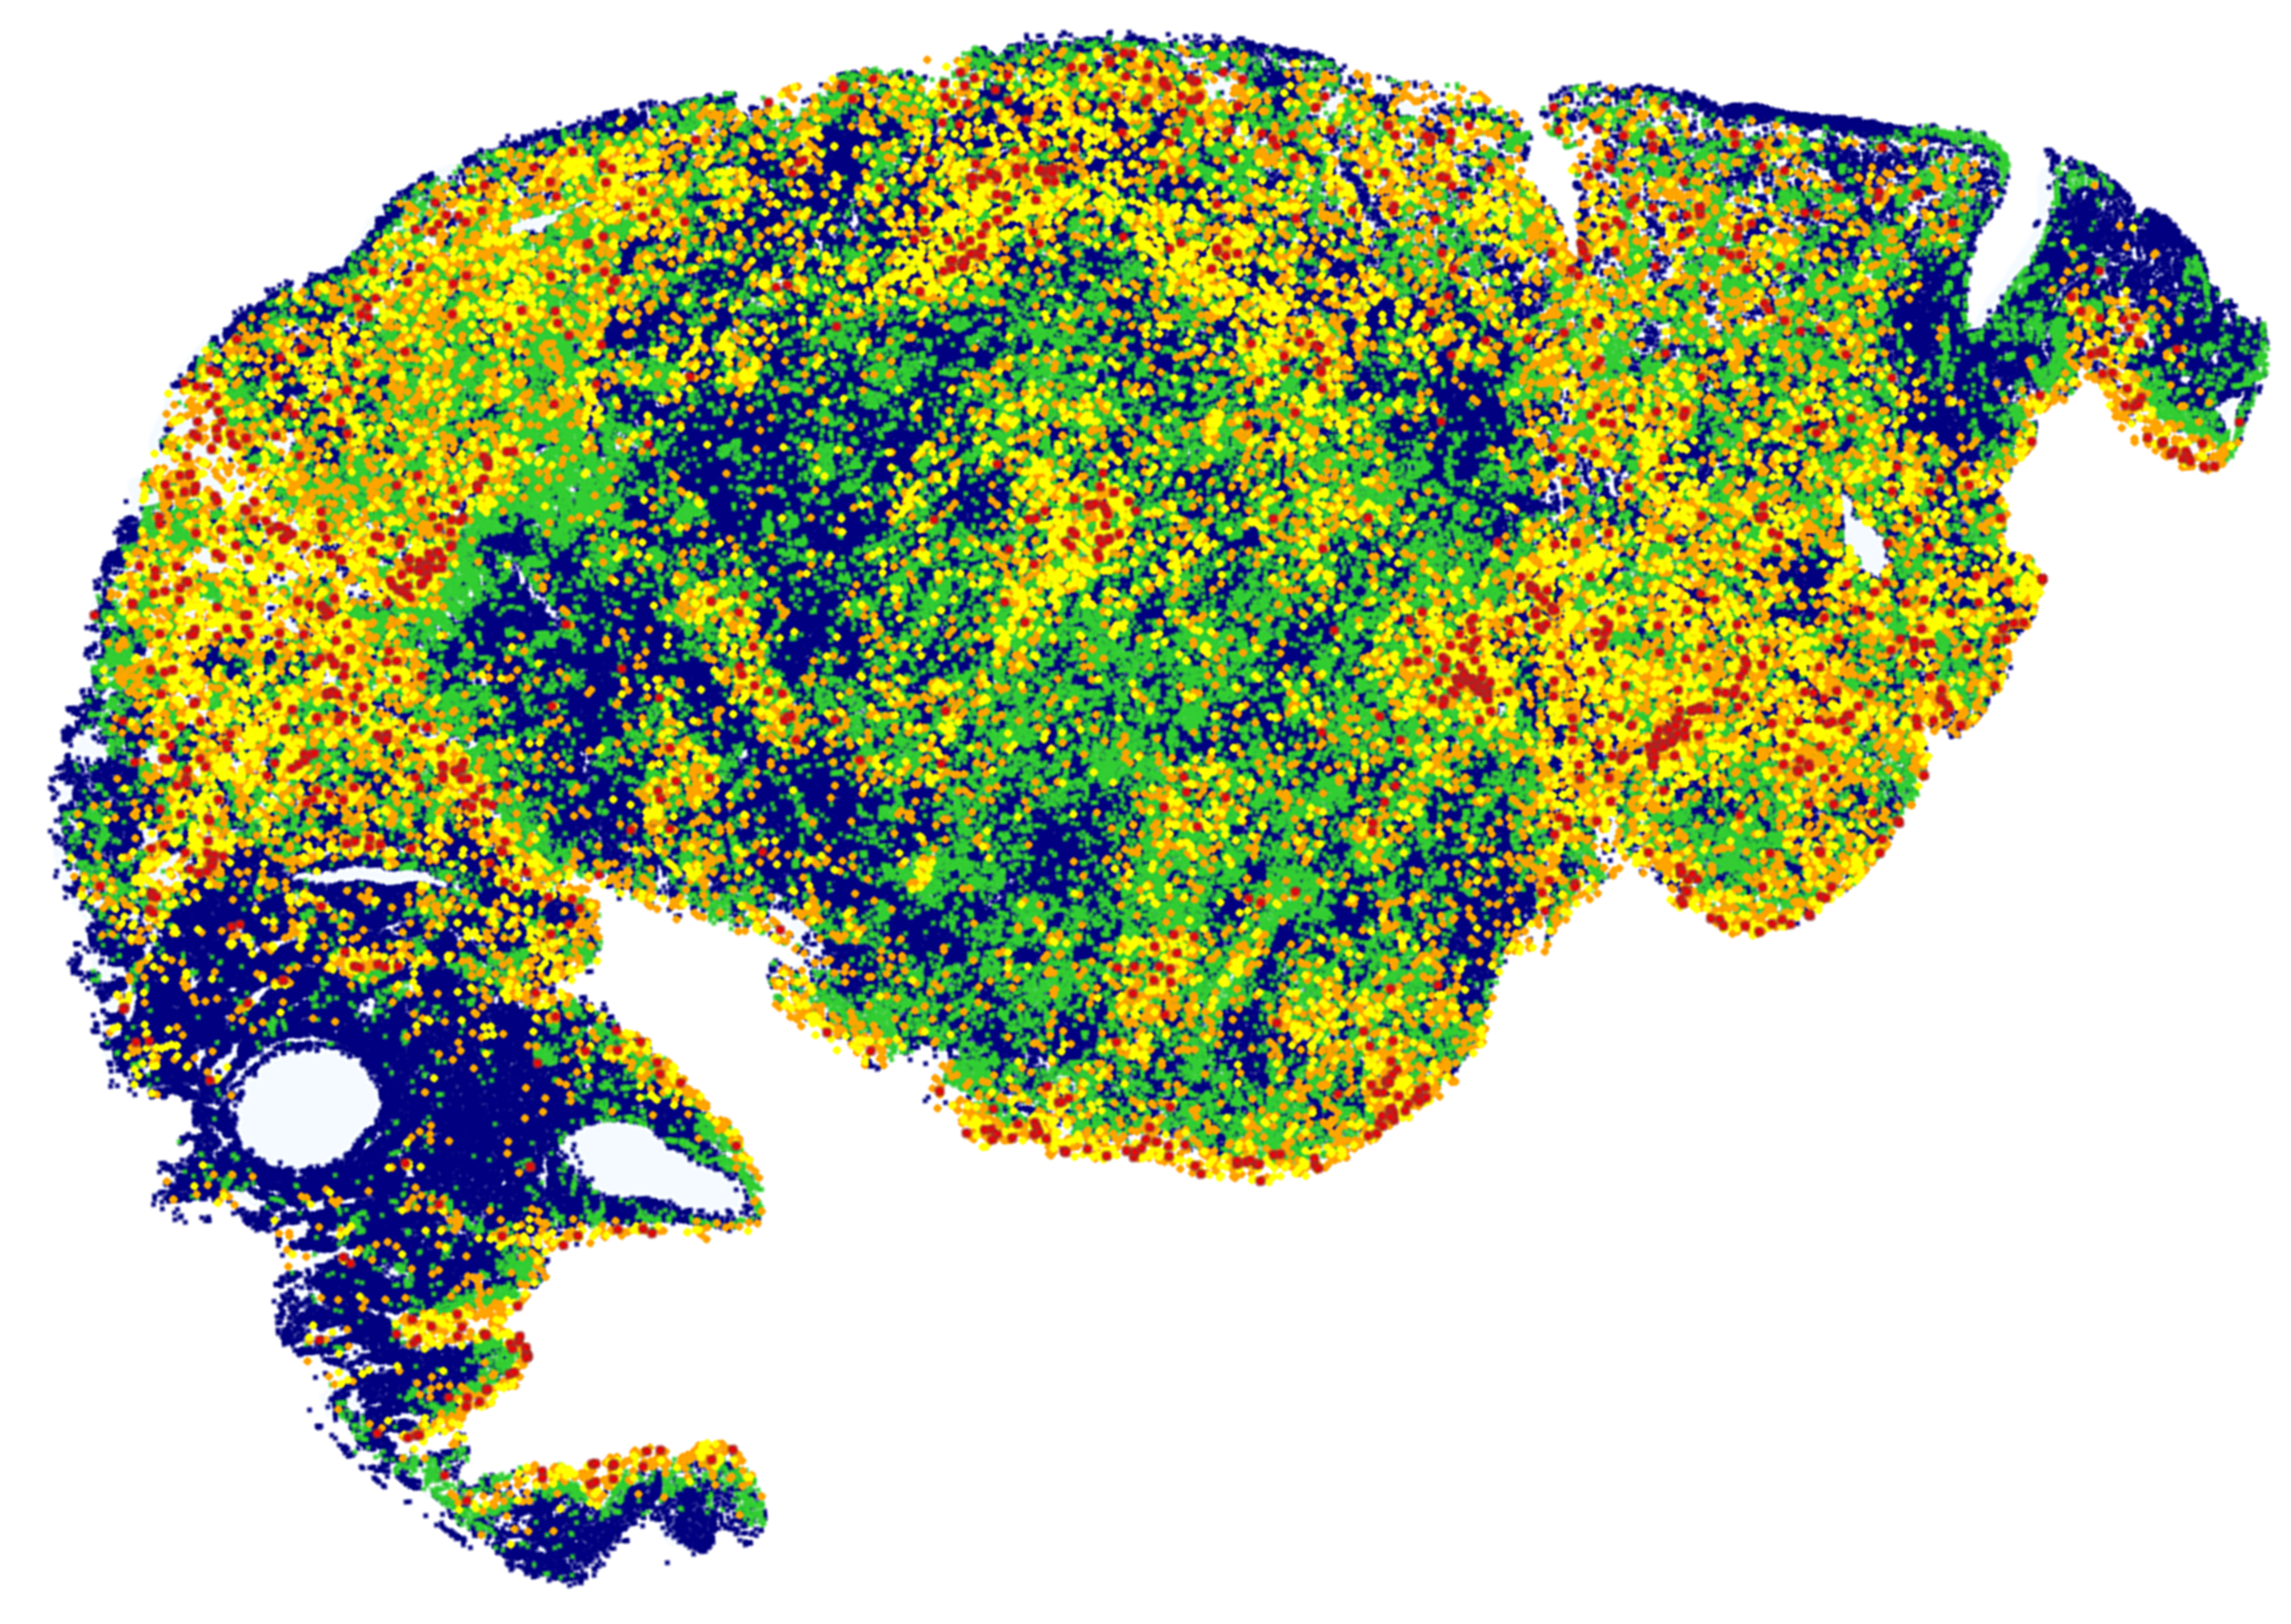
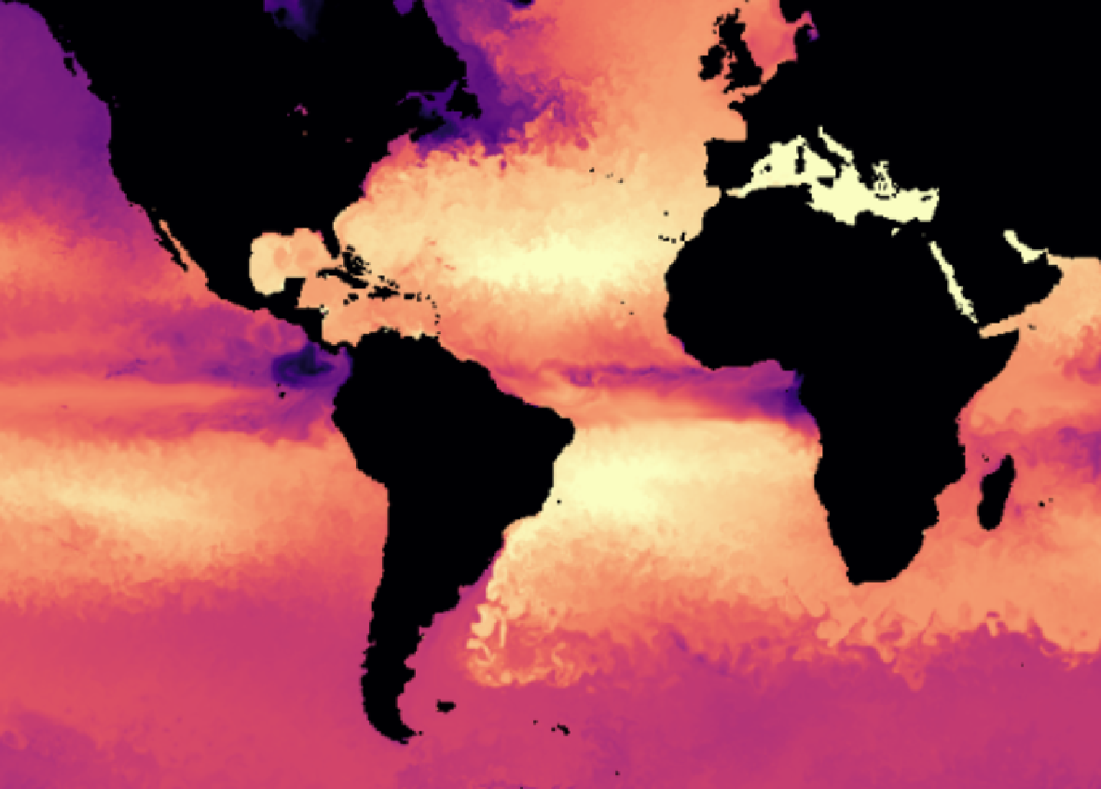
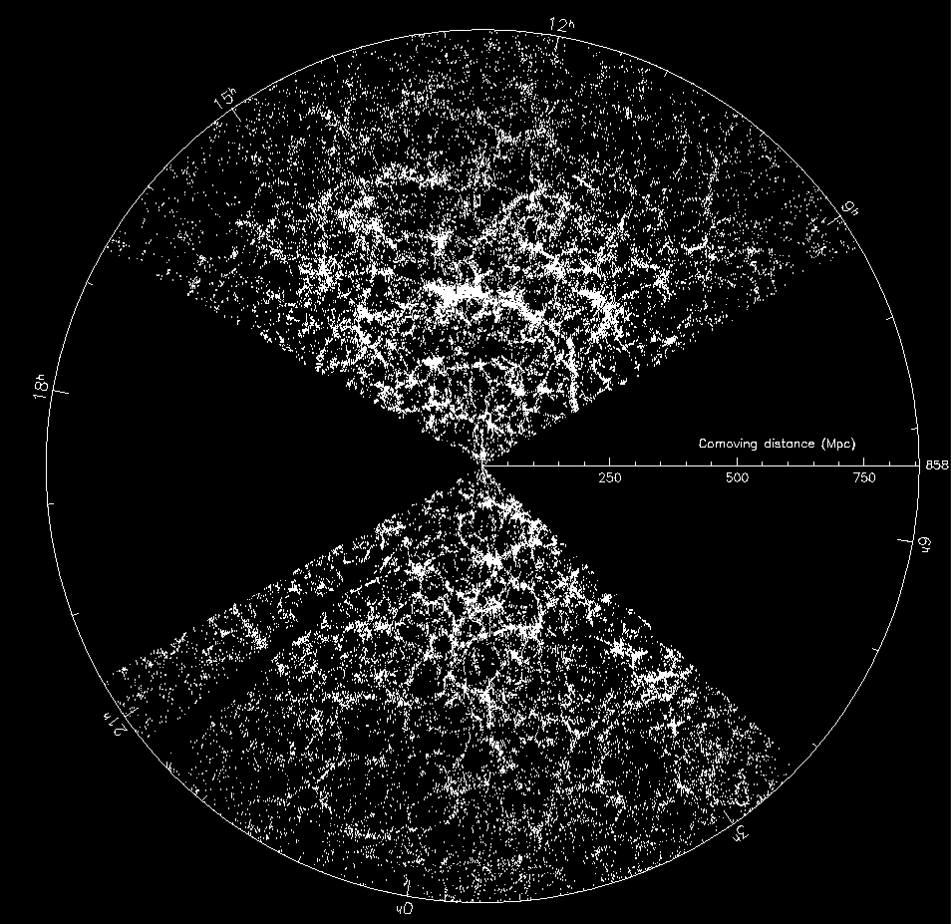
Recent Key Data Projects at JHU
Leapfrog – “non-incremental”
(2001- ) Sloan Digital Sky Survey (SDSS) – increased sky survey data by a factor of 100, still the world’s most used astronomy facility, 4.2B web hits, 660M SQL queries, 10M users, 10K papers, 500K citations
(2006- ) Turbulence database (JHTDB), hosting the world's largest simulations now becoming the "virtual observatory" of turbulence, 1.5PB of data, 181 trillion points delivered to the world
(2016- ) AstroPath – 1000-fold increase in data for cancer immunotherapy, taking SDSS lessons to pathology, soon Open Cancer Cell Atlas with billions of cells 16Trillion pixels, 500M cells
(2017- ) POSEIDON: building the world's largest ocean circulation model, increasing resolution by 10x and turning it into an open interactive resource, 2.5PB of data on its way
Building on SDSS we are able to create unique leapfrog projects over and over

Slide 8

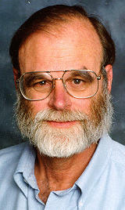
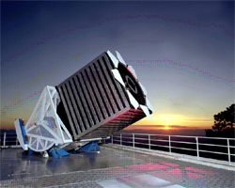
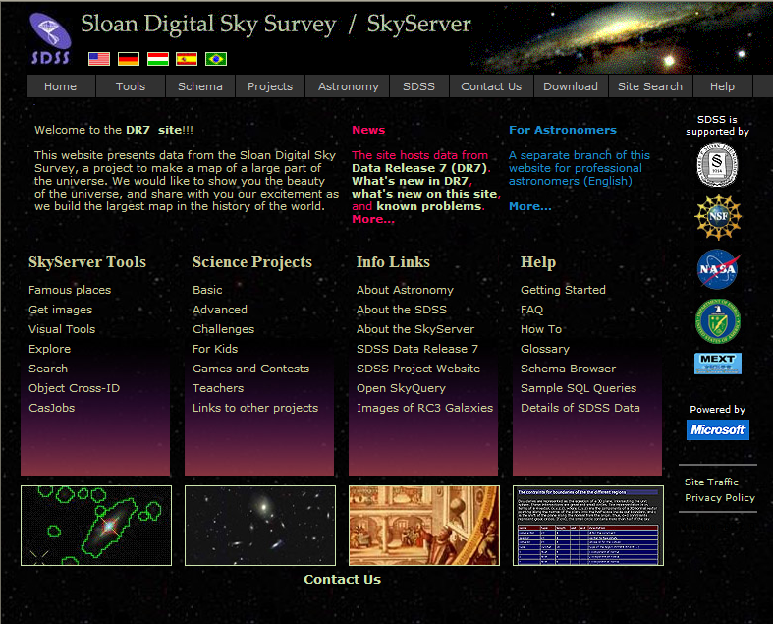
Sloan Digital Sky Survey
“The Cosmic Genome Project”
Started in 1992, SDSS-II finished in 2008
Data is entirely public
5 T unique pixels of sky
100TB processed data => 8.5 Tpix
35TB database
Database and spectrograph built at JHU
SDSS-IV data served from JHU
Project marked a transition in astronomy
From manufacturing to mass production of scientific data
SDSS-V starting right now
Jim Gray
SkyServer: Prototype in 21st Century data access
Visual interface integrated with object-relational DB
Remarkably fast adaptation by the astronomy community
4.2B web hits
664M external SQL queries (excluding robots)
10,000+ papers and 500K+ citations
10,000,000 distinct users vs. 15,000 astronomers
The emergence of the “Internet Scientist” => GalaxyZoo
Still the world’s most used astronomy facility today
Collaborative server-side analysis done by 10K astronomers
The first “cloud computing” project in science (2002)

Slide 9
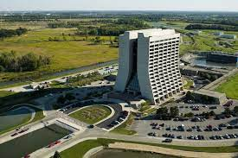




SDSS dataflow
First the SDSS telescope,
From SDSS-V many telescopes
Many different data access models
Get the raw data
Use the database
Combine DB and raw data server side
Extensive world-wide usage
JHU effort started in 1992
Starting to worry about the long-term future of the data beyond the life of the instruments
Shared computing
First FNAL, then Utah HPC center
Flat Files
SkyServer

Slide 10
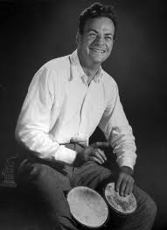
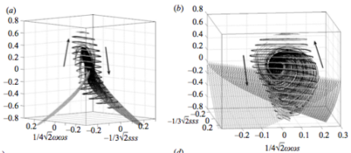
Immersive Turbulence
“… the last unsolved problem of classical physics…” Feynman
Understand the nature of turbulence
Consecutive snapshots of a large simulation of turbulence: 30TB
Treat it as an experiment, play with the database!
Shoot test particles (sensors) from your laptop into the simulation, like in the movie Twister
50TB MHD simulation
Now: channel flow 100TB, MHD 256TB
8K³ simulation
New paradigm for analyzing simulations!
181 Trillion points delivered in the last 8 years
Total of 650TB of simulations accessible
http://turbulence.pha.jhu.edu/
C. Meneveau, R. Burns, T. Zaki, G. Eyink, A. Szalay, E. Vishniac

Slide 11
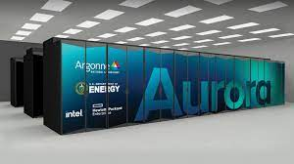
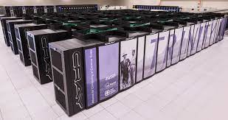
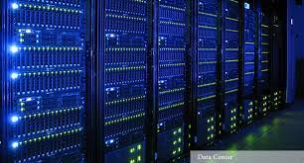
Turbulence Dataflow
Multi-use storage
Multiple different ways to access the data
Supporting all three modalities
Download big files
Use web service to get discrete cutouts
Use web service to get position of test particles
Web service to do Lagrangian particle tracking
Various cloud services to get dissipation, vorticity
Data conversion
JHU TurbDB
Cutout service
Particle tracking

Slide 12
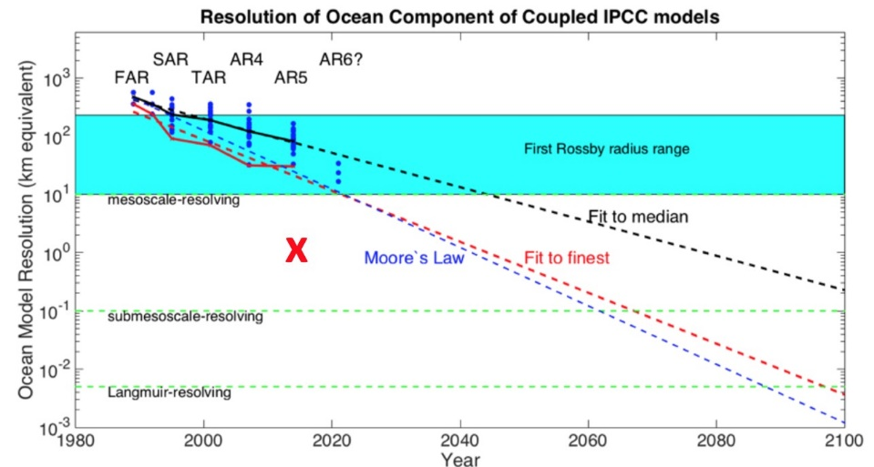
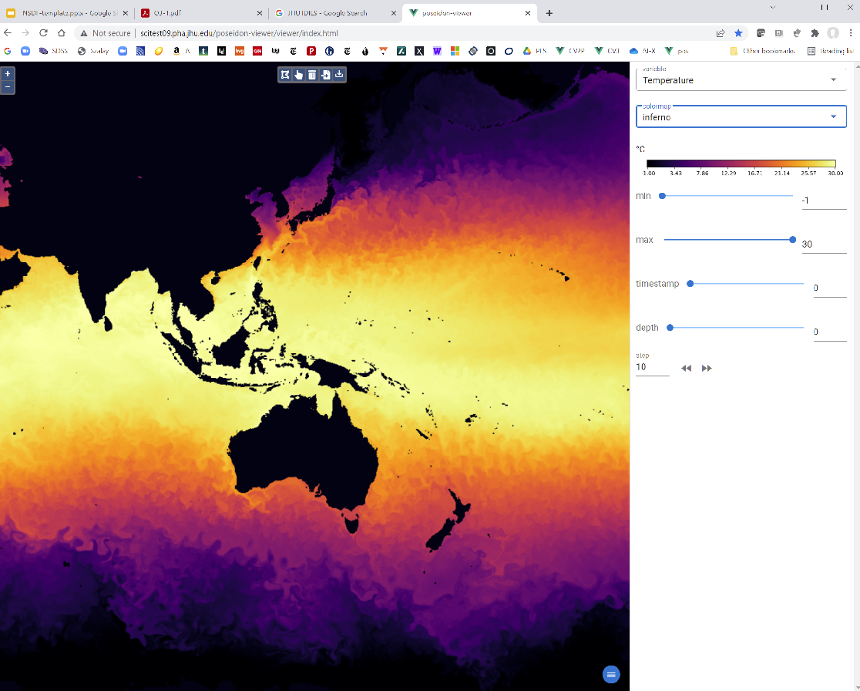
Poseidon: 2.5PB Ocean Laboratory
1km resolution whole Earth model, 1 year run
Collaboration between JHU, MIT, Columbia
T. Haine, C. Hill, R. Abernathey, R.Gelderloos, G. Lemson, A. Szalay, NSF $1.8M
Uses the MIT GCM model
Goal is to provide an interactive open access to 2.5PB data
Key is to have on-the-fly visual browsing
Interactive Poseidon viewer, needs to interpolate LLC grid in real time
Interactive server-side access to the best domain tools
OceanSpy – SciServer-based, wrapping deep domain codes
Large scaleout computing in the Google cloud
Simultaneous OSN-based access to data, computations in the Google cloud, stream and discard data (R. Abernathey)

Slide 13
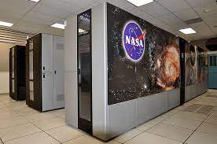
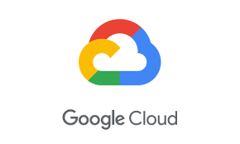

Poseidon Data Flow
Multiple data access modes
PB scale data movement via OSN
Unique feature is the cloud stream/discard
Challenge is that all these are done on top of a single storage model!
Data size prohibits multiple transformations
Hierarchy of tradeoffs in access modes
Viewer – simple service, low latency
OceanSpy – sophisticated tools, needs server side access, still interactive
Large-scale – off-line, scaleout in Google
NASA Ames Pleiades
OSN
JHU Poseidon
Viewer

Slide 14
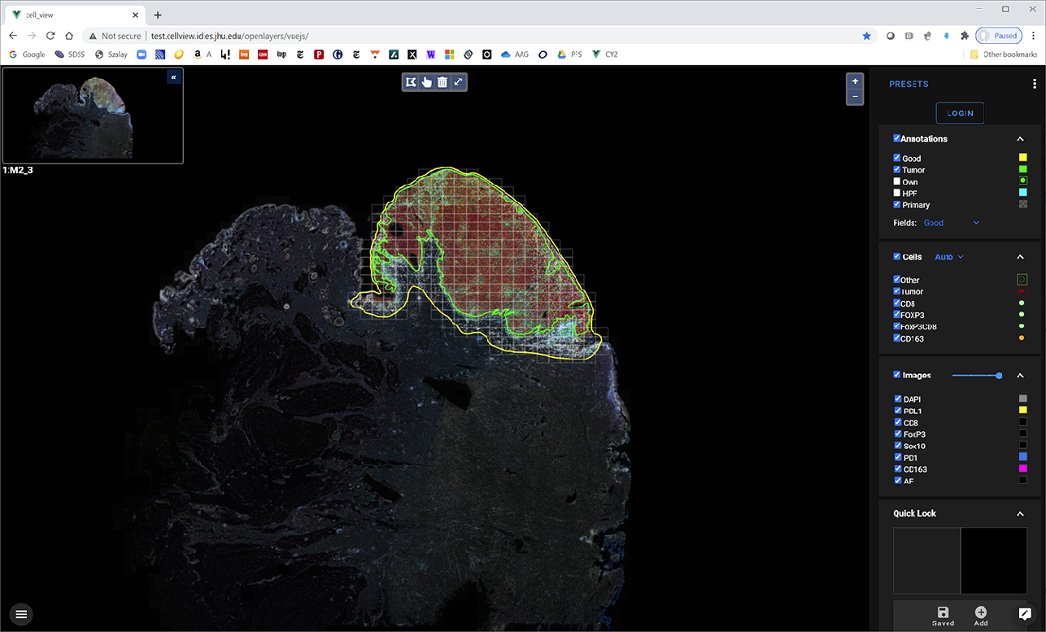
AstroPath: Atlas of Cancer Cells
Astronomy meets Pathology
with Prof. Janis Taube (JHMI BKI)
Studying the tumor microenvironment to understand cancer immunotherapy
Spatial interactions of activated T cells and tumor near the tumor boundaries
Transitioning to the “industrial revolution”
Goal: increase data collection by a factor of >1,000
400GB mosaic of 35-band multiplex images/slide (from 10 to 2000 images/slide)
7 markers (lineage + PD-1, PD-L1), more markers via additional panels
Use a farm of automated microscopes => 2PB/year
Heavy use of parallel processing
Parallels sky surveys (as of 20 years ago)
“Disruptive assistance” from astronomy to pathology
Using techniques astronomers learned the hard way (flat field, unwarp, calibrate)
Next: planning to start an Open Cancer Cell Atlas with images of TCGA samples
Demostrates that one can share cyberinfrastructure between fields as remote as astronomy and cancer pathology
Current data in the database
6 Cohorts, 496 slides
336,033 High Powered Fields
510M detected cells
229M unique cells
5.9B cell pairs
15.9 trillion pixels (whole SDSS was 6.5 Tpixels!)
Additional 100+ slides already scanned with multiple tumor types

Slide 15



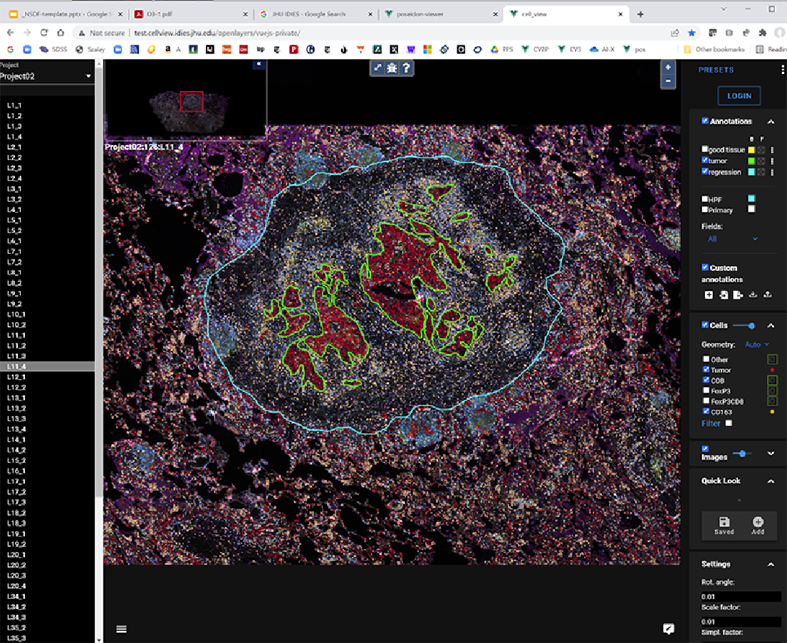
AstroPath Scalability
Microscopes
Compute Cluster
JHU
Pool of 6 automated microscopes
Dramatically decrease human labor
Automate tissue segmentation with Deep Learning for cell recognition
Spatial DB scalable to many billions of cells
Integrate with genomics and medical records
Working in MOCCA: MARK Open Cancer Cell Atlas
Storage
Spatial Database

Slide 16
Commonalities
Data too large to store in multiple versions or multiple places (other than required for redundancy)
We still need to support multiple access patterns from low latency immediate visualizations to large streaming scaleout
All applications include Jupyter access
Many data transformations present for
quick look viz (must be low latency)
data ingest (must have high sequential throughput)
Most of these can be implemented using the NSDF approach

Slide 17
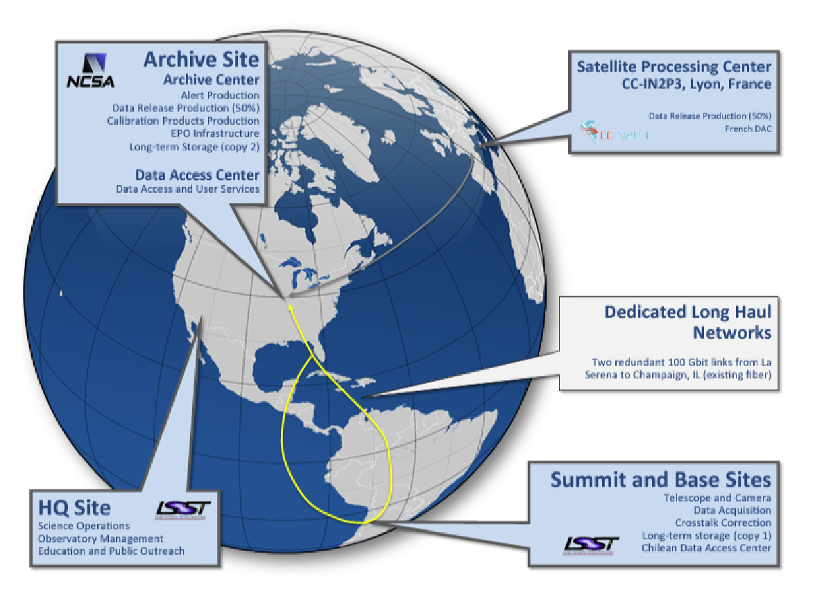
Emerging: Time Domain Astronomy
Multiple $B experiments: LIGO, LSST/Rubin
Complex global dataflow
Just switched to more opportunistic computing
Real-time alerts generated (within 1 min)
World-wide follow up of transients
Complete game changer – a new unknown dimension is opening up
Challenges
Multiwavelength cross-correlations
Multimessenger alert processing with millions of events
Latency is critical for transient follow up

Slide 18
Future-Proofing Our Computational Model
We need to get on a future-proof trajectory (that can adopt over the years)
We need to keep the main long-term data out of the cloud (for now, but be ready to overflow)
Move enough data in just in time
AI training needs lots of cycles, but no long-term storage (may fit the cloud model)
Eventually we will need to cross correlate between data in different clouds
Need to move PB scale data sets -- fast!
There will always be many different access modes
We cannot afford to store the data in so many ways
Must be easy to perform on-the-fly conversions
Don’t lose focus on preserving the valuable data sets
We need the National Science Data Fabric

Slide 19
